Slide 1
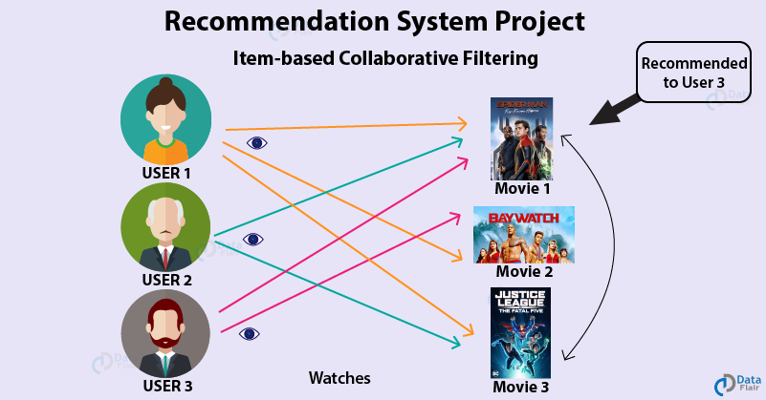
netflix Collaborative Filtering
Group:
Evghenii Gaisinschii
Baruh Rutman
Roi Amzaleg

Slide 2
Contents
Overview
Netflix collaborative filtering
Challenges
Deployment
Auxiliary information
The main limitations
Innovations
References

Slide 3
Overview
In this topic we will talk about NETFLIX recommender system.
Collaborative filtering is a technique used by recommender systems.
It is a method of making automatic predictions about the interests of a user by collecting preferences or taste information from many users.
The underlying assumption of the collaborative filtering approach is that if a person A has the same opinion as a person B on an issue, A is more likely to have B's opinion on a different issue than that of a randomly chosen person.
For example, NETFLIX collaborative filtering recommendation system could make predictions about which movie or series a user should like given a partial list of that user's tastes. Note that these predictions are specific to the user, but use information gleaned from many users.

Slide 4
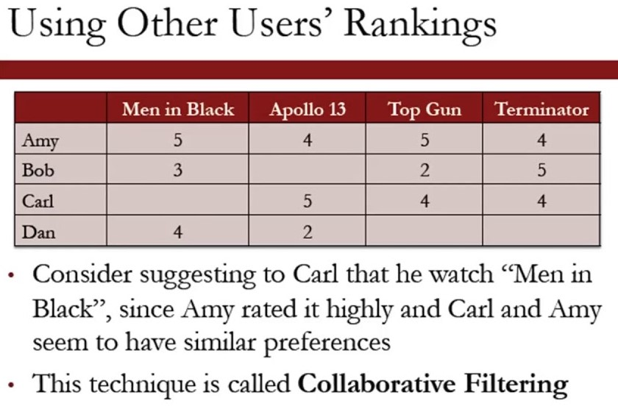
Netflix collaborative filtering

Slide 5
Challenges
Rating also stems from personal and cultural characteristics (4 stars have different meanings for different people).
Sometimes we accidentally click or fall into traps.
It is difficult to evaluate the quality of a product recommendation that the user has never seen.
A large amount of relevant results and their order.
Difficult to assess without sufficient information about all preferences.
Users whose opinions do not consistently agree or disagree with any group of people and thus do not benefit from collaborative filtering.
Data sparsity
Scalability
Synonyms
Gray sheep
Shilling attacks
Diversity and the long tail

Slide 6
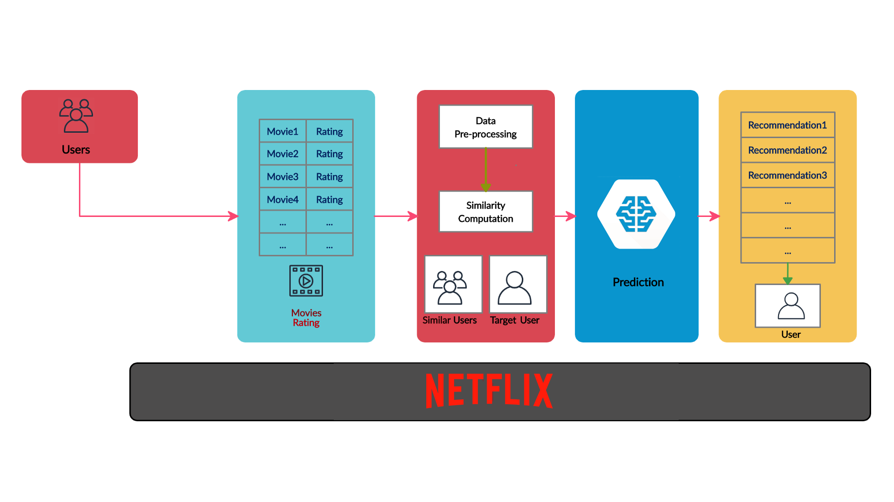
deployment
Measure how good is the system in predicting the exact rating value (value comparison)
Measure how well the system can predict whether the item is relevant or not (relevant vs. not relevant)
Measure how close the predicted ranking of items is to the user’s true ranking (ordering comparison).

Slide 7
Auxiliary information
The worst case complexity is O(M*N) (M customers and N products)
Typical examples of this approach are neighbourhood-based CF and item-based/user-based top-N recommendations. (Memory-based)
The neighborhood-based algorithm calculates the similarity between two users or items, and produces a prediction for the user by taking the weighted average. Multiple measures, such as Pearson correlation and vector cosine based similarity are used for this.
Model-based models are developed using different data mining , machine learning algorithms to predict users' rating of unrated items. There are many model-based CF algorithms. Bayesian networks, clustering models and others.
Netflix offered an award for lowering RMSE (root mean squared error) values and thus focused the industry and research on a particular index.

Slide 8
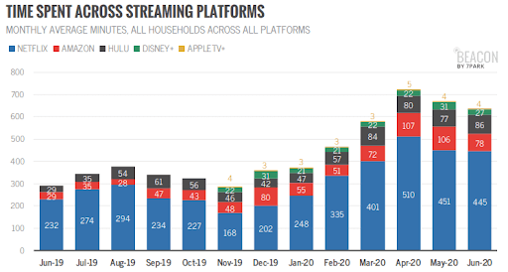

Slide 9
The main limitations
Difficult to know what is relevant for a user in a recommender system that manages thousands/millions of products.
For example, in the collaborative filtering case this could be measured as the number of items that a user must rate before receiving recommendations.
As we have noted above, collaborative filtering recommenders tend to improve their accuracy as the amount of data over items grows. Similarly, the confidence in the predicted property typically also grows with the amount of data.
In a collaborative filtering system, a user willingly discloses his preferences over items to the system in the hope of getting useful recommendations. However, it is important for most users that their preferences stay private, that is, that no third party can use the recommendation system to learn something about the preferences of a specific user.

Slide 10
Innovations
New algorithms have been developed for CF as a result of the Netflix prize.
Cross-System Collaborative Filtering where user profiles across multiple recommender systems are combined in a multitask manner. This way, preference pattern sharing is achieved across models.
Robust collaborative filtering, where recommendation is stable towards efforts of manipulation. This research area is still active and not completely solved.
Should make the choice easier and robust.

Slide 11
References
Evaluating Recommendation Systems, Guy Shani and Asela Gunawardana, 2010, pp(4,7,18,21)
Evaluating Collaborative Filtering Recommender Systems, JONATHAN L. HERLOCKER Oregon State University and JOSEPH A. KONSTAN, LOREN G. TERVEEN, and JOHN T. RIEDL University of Minnesota, 2004
F. Ricci et al. (eds.), Recommender Systems Handbook, DOI 10.1007/978-0-387-85820-3_8, © Springer Science+Business Media, LLC 2011
Cross System Personalization and Collaborative Filtering by Learning Manifold Alignments, Bhaskar Mehta and Thomas Hofmann, Advances in Artificial Intelligence, 29th Annual German Conference on AI, KI 2006, Bremen, Germany, June 14-17, 2006, Proceedings

Slide 12
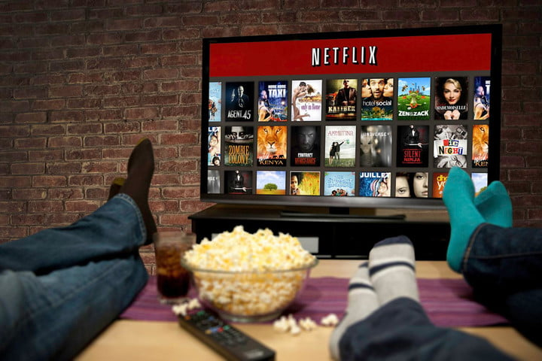

Slide 13
Challenges
יש לשים לב - ביקורת נובעת גם ממאפיינים אישיים ותרבותיים
( ל 4 כוכבים יש משמעות שונה עבור אנשים שונים)
לעיתים אנחנו מקליקים בטעות או נופלים למלכודות.
יש לשים לב להבדל הצגת כל התוצאות לכמות האפקטיבית שאכן תהווה המלצה עבור המשתמש. לכן כדאי לדרג את התוצאות ולבחור את N הטובות.
קשה לתת הערכה לטיב המלצה על מוצר שהמשתמש מעולם לא ראה.

Slide 14
Auxiliary information
נטפליקס הציעה פרס להורדת ערכי RMSE וכך מיקדה את התעשיה והמחקר במדד מסוים.
הפער בין דירוג רע - לחיזוי דירוג רע ישפיע על RMSE האם זהו פער שרלוונטי להמלצות ?
The worst case complexity is O(m²*n) (m customers and n products) – for each user calculate nearest neighbors – O(m*n)
Netflix offered an award for lowering RMSE values and thus focused the industry and research on a particular index.

Slide 15
Context-aware collaborative filtering

Slide 16
Types
Look in the slide notes below for topics to consider talking about
Notes:
Consider talking about:
Memory-based
Model-based
Hybrid
Deep-Learning

Slide 17
Application on social web
Look in the slide notes below for topics to consider talking about
Notes:
Consider talking about:
Problems

Slide 18
Challenges
Look in the slide notes below for topics to consider talking about
Notes:
Consider talking about:
Data sparsity
Scalability
Synonyms
Gray sheep
Shilling attacks
Diversity and the long tail

